Slide 1
Containers & Orchestration
@ .net core web development
Guven Aslan

Slide 2








Containerization
Containerization involves bundling an application together with all of its related configuration files, libraries and dependencies required for it to run in an efficient and bug-free way across different computing environments
Build Ship Run
From Dev
To OPS
Any App
Containerization Engine
Any OS
Windows
Linux
Anywhere
Physical
Virtual
Cloud

Slide 3
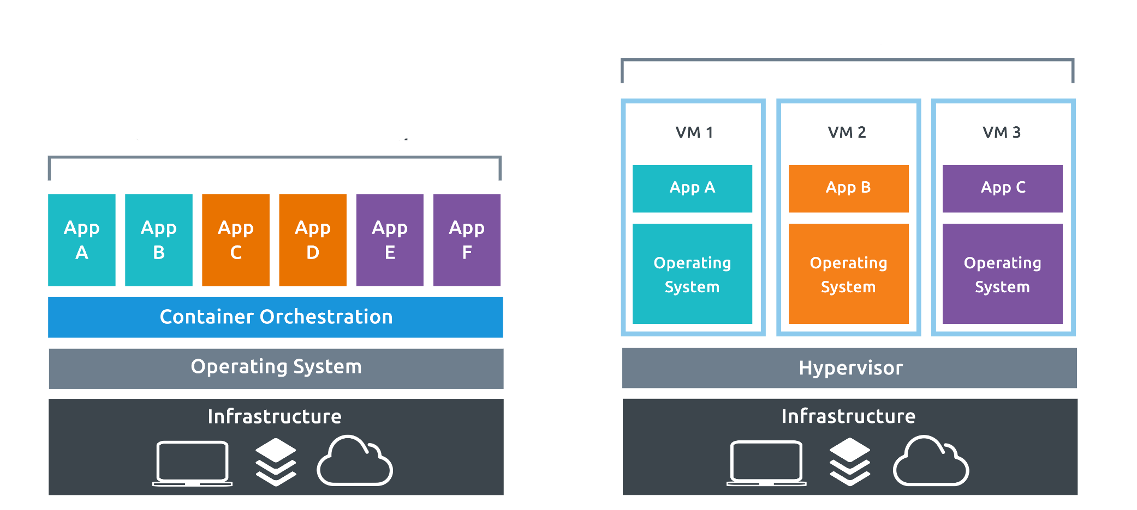
Benefits of Containerization
Ease of Deployment and Configuration
High Scalability
Pipeline Management
Increased Overall Productivity
Process Isolation
Virtualised Approach
Containerised Approach

Slide 4

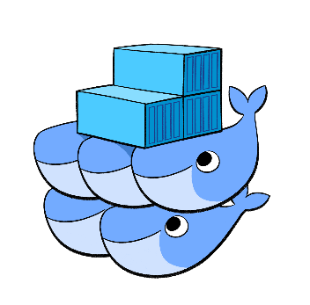
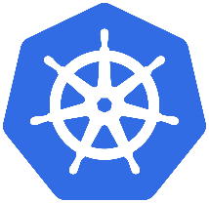
Docker & Docker Swarm & Kubernetes
Docker is a set of platform-as-a-service products that use OS-level virtualization to deliver software in containers.
Docker Swarm is a clustering and scheduling tool for Docker containers. With Swarm, IT administrators and developers can establish and manage a cluster of Docker nodes as a single virtual system.
Kubernetes is an open-source system for automating deployment, scaling, and management of containerized applications.

Slide 5
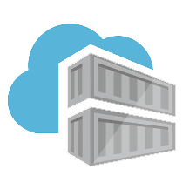
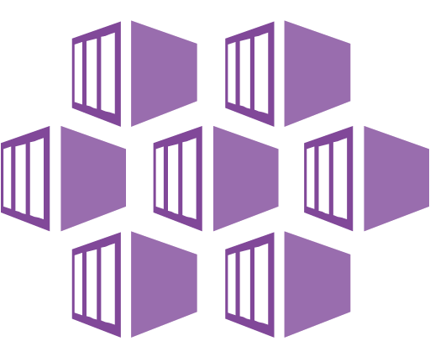
Azure Container Registery & Kubernetes Service (AKS)
Azure Container Registry allows you to build, store, and manage images for all types of container deployments.
Azure Kubernetes Service (AKS) is a managed container orchestration service, based on the open source Kubernetes system, which is available on the Microsoft Azure public cloud. An organization can use AKS to deploy, scale and manage Docker containers and container-based applications across a cluster of container hosts.

Slide 6






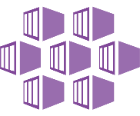



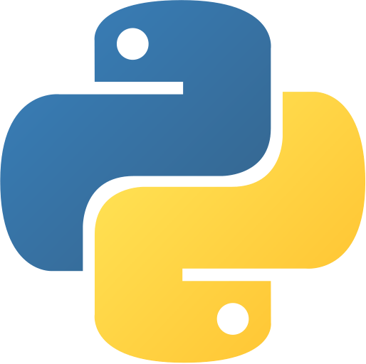
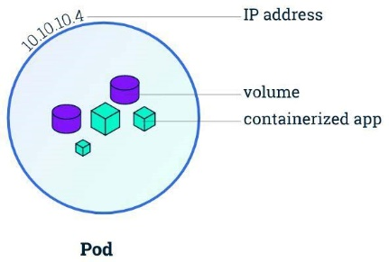
Simple Workflow
Azure Container Registry
Azure AD
Dev
Git
AKS
Pod
Pod
Web Access
Pod
Pod
Pod
Pod
Admin Access

Slide 7

Demo - Dockerize an Asp.net Core application
Docker File creation
How to find Runtime?
Expose 80 Port
Build & Run
Useful docker commands
Download a image from Docker Hub registry
List containers
List local storage images
Display the logs of a container
Removes one or more containers

